Slide 1

Newington
Town Council
13 October 2002
COMMUNITY CONNECTIVITY GRANT PROGRAM
FOR
Main Street Sidewalk Connectivity Project

Slide 2
Community Connectivity Grant Summary
Connecticut Department of Transportation (CDOT)
Competitive application processes (169 Towns)
Small scale improvements
$125k to $600k per town
Improve pedestrian and bicycle safety and accessibility
Includes construction activities only
Excludes engineering/design costs

Slide 3
Grant Application Timeline
Grant Solicitation Announced – 28 AUG 2020
Public Works Meeting – 9 SEPT 2020
Assessed need & identified projects
Matched project to grant objectives
Prepared preliminary design, cost estimate, and schedule
Prepared public outreach presentation
Prepared draft grant application
Public Outreach – 6 OCT 2020
Town Council Meeting – 13 OCT 2020
Application Due – 16 OCT 2020

Slide 4
Project Origin

Slide 5
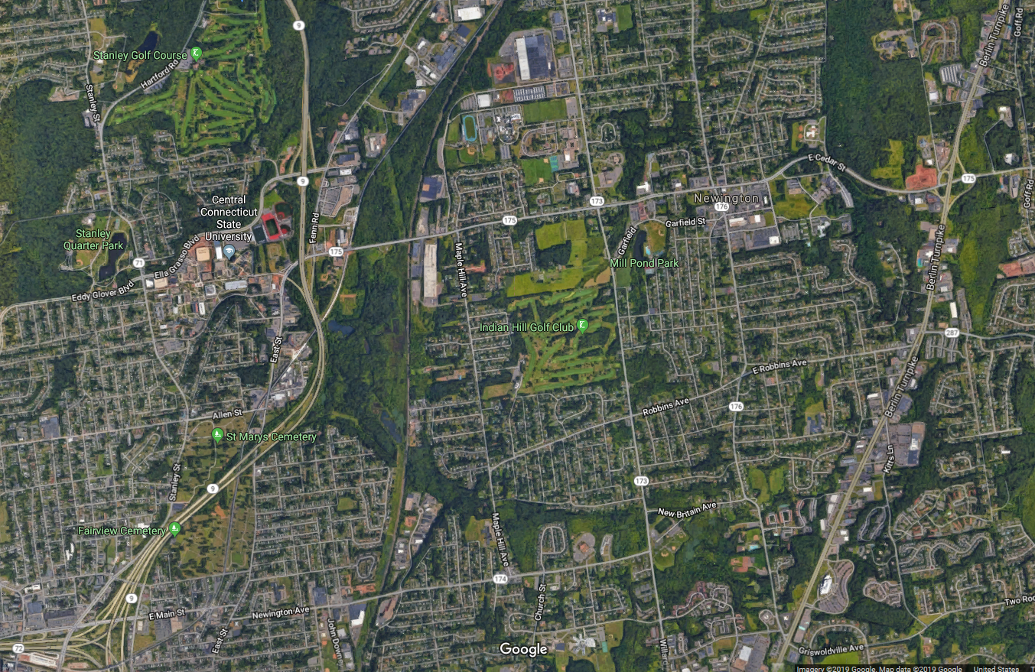
Project Corridor

Slide 6
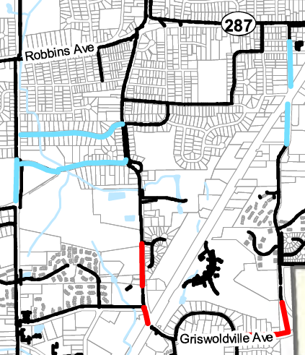
POCD – Pedestrian Plan
Extend sidewalks
Close sidewalk gaps
High priority sidewalk (red)
TON Project
CDOT Project 007-250

Slide 7
Preliminary
Design
Clearing
Sidewalk
Landscape

Slide 8
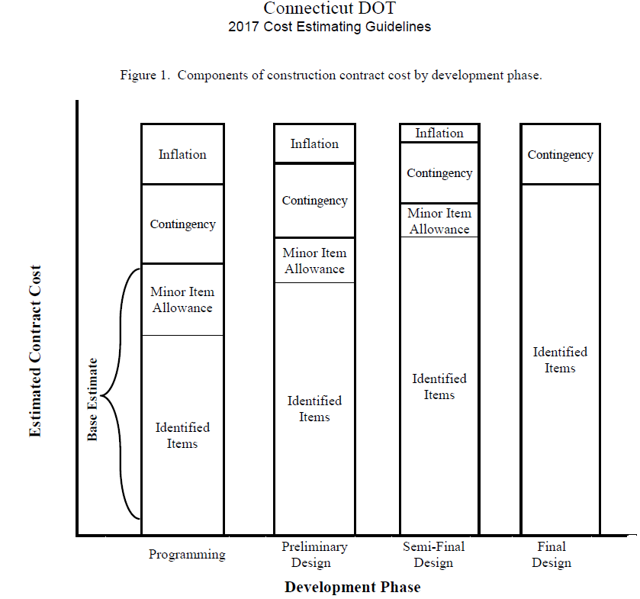
Cost Estimate
$525,000 = Total Cost
36 Major Items = $365k
Minor Item Allowance = $70k
Contingency = $45k
Incidentals = $45k
Inflation = $0k

